Slide 1
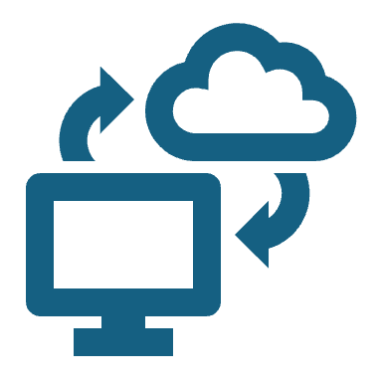
Topic 4 – Software as a Service (SaaS)
Understanding the SaaS Model, Examples, and Areas of Application

Slide 2

Introduction to SaaS
SaaS (Software as a Service) is a cloud computing model where applications are hosted by a provider and made available to users over the internet.
Key features:
No need for installation
Subscription-based pricing
Access from any device with internet
Provider manages infrastructure and updates

Slide 3
Evolution of Software Delivery
Traditional Model: Buy a license, install software on a local machine.
SaaS Model: Access software through a web browser, pay as you go.

Slide 4
SaaS Architecture
Multi-Tenancy: A single instance serves multiple customers.
Scalability: Can handle thousands of users without performance drop.
Automatic Updates: No manual upgrades needed.
Security & Compliance: Data encryption and access control managed by the provider.

Slide 5
SaaS vs Other Cloud Models
Feature | SaaS | PaaS | IaaS
Example | Gmail, Dropbox | Heroku, Google App Engine | AWS EC2, DigitalOcean
User Control | Least | Medium | Most
Maintenance | Managed by provider | User manages applications | User manages OS & apps
Use Case | Software applications | App development | Infrastructure for hosting

Slide 6
Benefits of SaaS
Cost-Effective: No upfront software purchase.
Accessibility: Use from any device, anywhere.
Scalability: Grow or shrink user base easily.
Security: Handled by professionals.
No Maintenance: No need to update or patch software.

Slide 7
Challenges of SaaS
Internet Dependency: No internet = no access.
Limited Customization: Some SaaS apps have restrictions.
Security Concerns: Data is stored by a third-party provider.
Vendor Lock-in: Difficult to migrate to another provider.

Slide 8
SaaS Pricing Models
Subscription-based (Monthly/Yearly) – Netflix, Office 365
Pay-as-you-go (Usage-based) – AWS Lambda, Twilio
Freemium (Basic free, paid premium features) – Dropbox, Slack

Slide 9
Examples of SaaS Applications
Productivity SaaS
Google Workspace (Docs, Sheets, Slides)
Microsoft 365
Dropbox
CRM SaaS
Salesforce
HubSpot
Zoho CRM

Slide 10
Examples of SaaS Applications
Communication SaaS
Slack
Zoom
Microsoft Teams
E-commerce SaaS
Shopify
BigCommerce
Wix

Slide 11
SaaS in Different Areas
1. SaaS in Business
Cloud-based accounting (QuickBooks)
HR & Payroll (BambooHR, Workday)
2. SaaS in Education
Online Learning (Coursera, Udemy)
Virtual Classrooms (Google Classroom)
3. SaaS in Healthcare
Electronic Health Records (EHR) systems (Athenahealth)
4. SaaS in Cybersecurity
Cloud-based security solutions (Cloudflare, Norton)

Slide 12
Choosing the Right SaaS Solution
Factors to Consider:
Pricing & Scalability
Security & Compliance
Integrations with other software

Slide 13
Risks & Security Concerns
Data Privacy: Ensure GDPR & compliance.
Downtime Risks: Choose reliable providers.
Cybersecurity Threats: Use MFA, encryption.

Slide 14
End of Topic 4
"The cloud is about how you do computing, not where you do computing." — Paul Maritz, Former CEO of VMware

